Slide 1

CSS-TRICKS
Guides and tricks to powerup your css

Slide 2

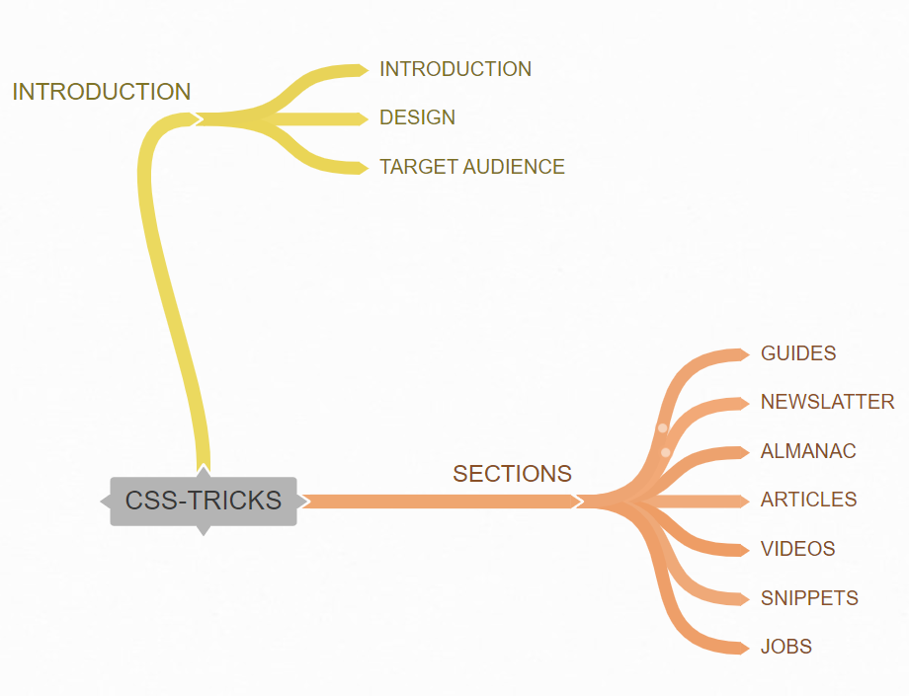

Slide 3
INTRODUCTION
GUIDES AND TRICKS FOR FRONT-END DESIGNERS AND DEVELOPERS

Slide 4

TARGET
FROM DEVELOPERS TO DEVELOPERS

Slide 5

MOST IMPORTANT
SECTIONS
GUIDES
ARTICLES
SNIPPETS
ALMANAC

Slide 6


